Slide 1
National Operations Center of Excellence 2023 TSMO Virtual Summit
Overview and Highlights
November 2023

Slide 2
Accelerating Deployment of Current & Emerging TSMO Practices
At the end of the Summit, NOCoE aspires that:
Thought leaders have shared learnings to establish an understanding of the problem.
Examples of current and emerging technologies/practices to frame what works and what is on the horizon.
A set of priorities and action items that will help and enable TSMO initiatives.
Communications and outreach goals to elevate the successes of TSMO practices.

Slide 3
Day 1 - TUESDAY (Sept 26) – 11:00 to 4:00 PM EST
Segment 1 11:00-12:15 | Setting the Stage – overview, expectations, keynote address.
Segment 2 12:30-2:15 | Current Trends, Performance, and Outcomes – inaugural trends summary, sample success stories.
Segment 3 2:30-4:00 | Data and Actionable Information Exchange – how do we accelerate digital infrastructure and use data/info to extend the benefits of TSMO?
Day 2 - THURSDAY (Sept 28) – 11:00 to 4:30 PM EST
Segment 4 11:00-12:45 | Organizing and Managing TSMO – institutional strategies to advance TSMO, role of funding, role of partnerships, ops manual.
Segment 5 1:00-3:15 | Bringing It Together for Safety – how can we better align TSMO and safety programs, how does the safe system approach fit in, are there broader policy objectives that align (e.g., mobility, sustainability, equity).
Segment 6 3:30-4:30 | Summing Up – concluding session to report out from many of the discussions, brainstorm prioritization, and follow-up activities.

Slide 4
Goals Achieved!
Understanding of the Problem
not only got breadth of the problem, but also the depth of the issues.
feedback from participants supplements and compliments the NOCoE trends survey.
What Works and What is on the Horizon
we had 60 organizations represented.
got a wide perspective and value in understanding what works and what is ahead of us.

Slide 5
Goals Achieved!
Priorities and Action Items
a number of speakers and participants had great suggestions that the NOCoE team will be following-up with.
specific “calls to action” from association leaders and FHWA – workforce, funding/procurement, safety – implementation relies on us doing something.
Communications and Outreach Goals
one of the successes of this summit was the engagement of the speakers and participants.
the input we received is very helpful for NOCoE to develop outreach products.
this will help NOCoE plan future webinars and peer exchanges.

Slide 6
Segment Highlights

Slide 7
TSMO Trends and Outcomes
Traffic Incident Management
Education and Training Collaboration
Balanced Technology Integration
Real-Time Information and Alerts
Traffic Signal Operational Improvements
Collaborative Partnerships for Efficiency
Investments in Data Collection & Use
The realm of transportation looks very different than it did when I joined the industry 25 years ago.
Dan Hurtado (FL DOT)
Be as innovative as possible, recognizing you are learning as you go, not everything will work.
Nicole Majeski (DE DOT)

Slide 8
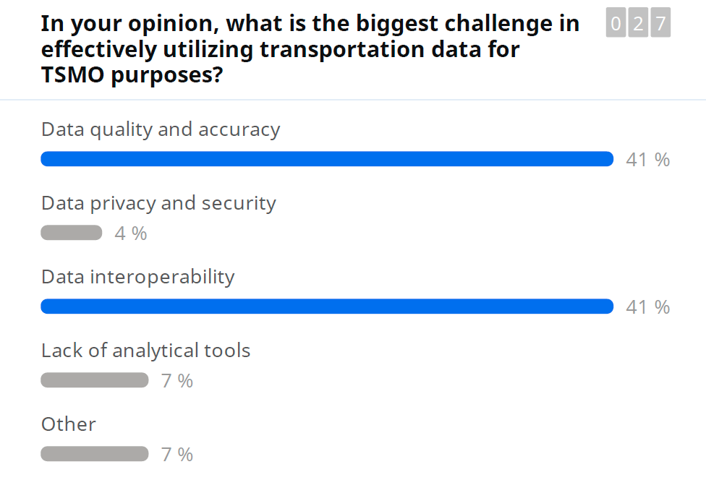
Data, Digital Infrastructure, Innovation
15 years ago, we complained about not having enough data to make decisions; today we almost have too much data and need to be strategic in how we analyze and utilize it.
Daniela Bremmer (Wash DOT)
You might have a hard time remembering the last time you utilized our transportation system without some type of technology, data, and communications that played a role.
Tim Drake (ITSA)
Notes:
Ben McCulloch - Strategic Data Scientist with TxDOT
Alexander Lemka - Data Systems Engineer with MCDOT

Slide 9
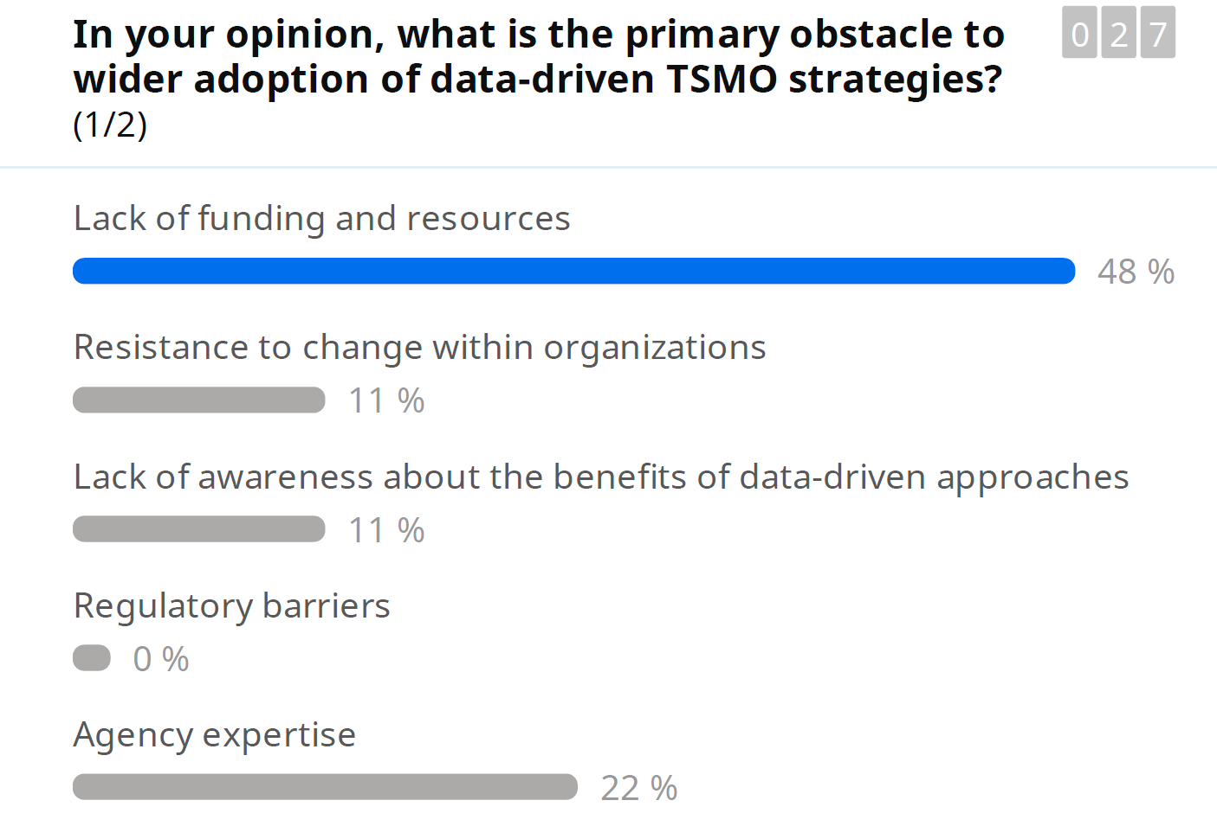
Data, Digital Infrastructure, Innovation
We need O&M funding from federal funds, particularly for technology and TSMO strategies that have different requirements from physical assets, cybersecurity, etc.
Laura Chace (ITSA)
Within transportation in general we’re trying to push a culture shift to talk about technology and operations in parallel with construction and building. We’re making progress but still have a ways to go.
Jim Tymon (AASHTO)

Slide 10
Organization
Agency organizational positions vary.
MPOs play a crucial role in regional plans, requiring different skill sets and with a focus on executive support.
Key performance indicators for TSMO include TIM, time to respond, detection, and travel time reliability.
Essential TSMO workforce skills include curiosity, positive activity demonstration, and showcasing value in emergencies.
Leadership support is critical.
Make sure your internal team has the resources they need to do their job – but also the coordination of that group with everyone else throughout the department.
Nicole Majeski (DE DOT)
Create a culture where your folks know you’re willing to take a risk.
Carlos Braceras (Utah DOT)

Slide 11
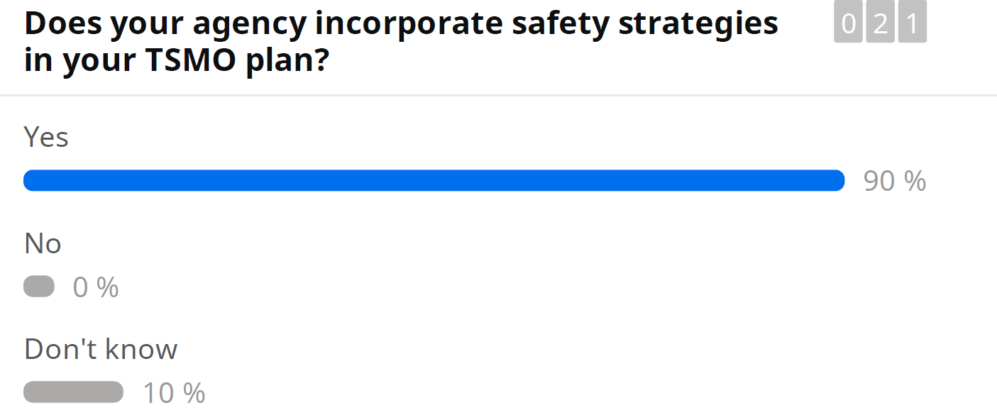
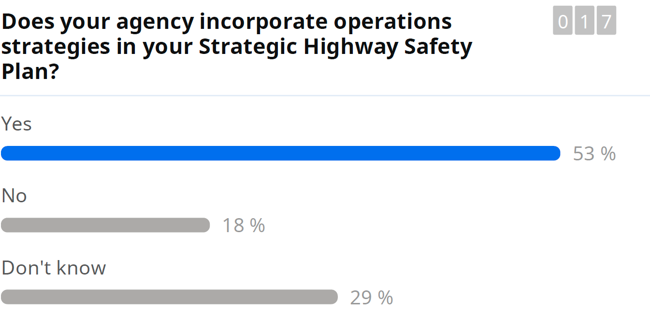
Safety
Alleviating congestion and moving cars were our early goals with ITS and TSMO. We need to push the two communities closer together – linking HSIP and TSMO plans, how we staff and organize people, what our performance measures are – all opportunities to walk the safety talk.
Jeff Paniati (ITE)

Slide 12
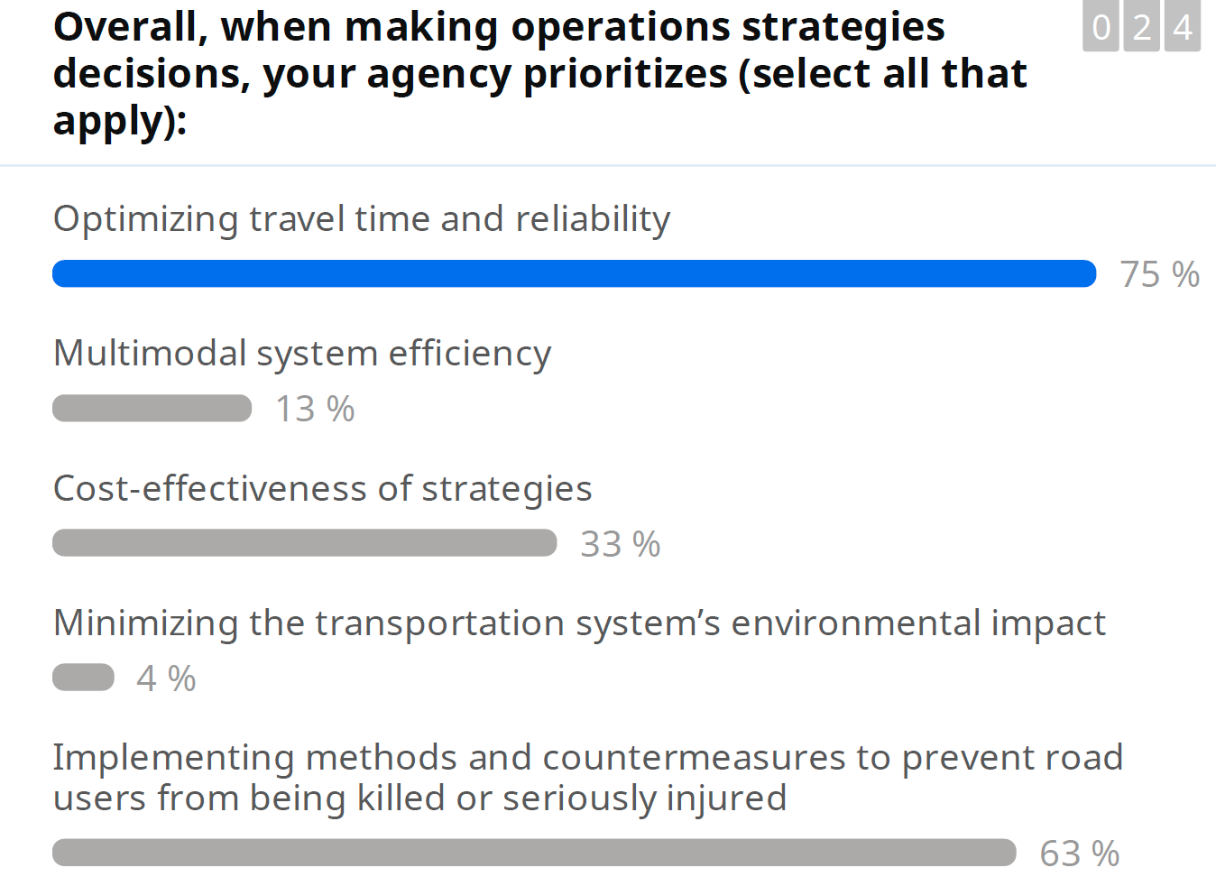
Safety
Unsafe mobility is not mobility at all.
Robert Wunderlich (TTI)

Slide 13
Additional Lessons and Input
Plans, Documents, & Metrics Matter
We Still Can Improve Our Messaging
It’s important to write stuff down, document - will help with age gap in work force and of course with leadership changeovers.
Jennifer Portanova (NC DOT)
It’s easy to make assumptions, but having performance measures for YOUR agency are valuable – having that traceability and having leadership buying into those goals is important.
Les Jacobson (WSP)
We still have to work toward making our case – WHY its so valuable to what we do – have this huge infrastructure we’ve invested in.
Beverly Kuhn (TTI)
We sometimes move too quickly past success stories and miss out on the opportunity to create sense of pride. Operations is the “cool side” of what we do. We take recruits to the TMC, not the CAD machines the engineers are working on.
Carlos Braceras (UT DOT)

Slide 14
What’s Next
NOCoE's next steps involve championing safety initiatives, leveraging insights from the Summit to inform strategies, and actively contributing to the ongoing dialogue on TSMO.
This not only aligns with NOCoE's mission but also reinforces its commitment to being at the forefront of transformative developments in the transportation sector.
We need to make sure that the outcome of summit is a “bias toward action”
Scott Marler (Iowa DOT)

Slide 15
Thank You!
Steve Kuciemba
ITE Executive Director/CEO
skuciemba@ite.org

